Slide 1
MANAGING COLLABORATION - FILE

Slide 2
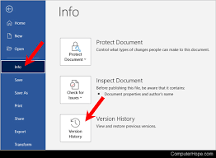
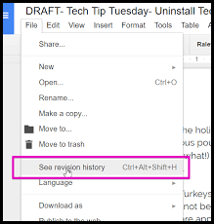
In collaborative environments, file versioning is important to track changes and avoid overwriting each other’s work.
Version History: Cloud services like Google Docs or Microsoft OneDrive allow users to view and restore previous versions of a file. This ensures that even if a mistake is made, it can be undone.

Slide 3
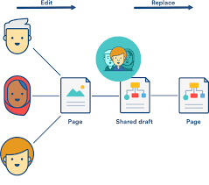
Collaborative Editing: Many platforms allow multiple users to edit a file simultaneously. Real-time collaboration requires proper version control and communication.

Slide 4

FILE CLEAN UP AND DELETION
Over time, files can accumulate and take up space. Regular file cleanup can help keep the system organized.
Deleting Files: When files are no longer needed, it’s important to delete them to free up space. However, be careful when deleting files, especially important ones, as they may not be recoverable.

Slide 5

Deleting Files:
Windows:
Right-click the file and select Delete, or select the file and press Delete on your keyboard.
Files will be moved to the Recycle Bin, from where they can be restored if necessary.
Mac:
Drag files to the Trash, or right-click and select Move to Trash.

Slide 6

FILE MANAGEMENT TOOLS
Various tools can assist in managing files:
File Explorer (Windows) / Finder (Mac): These are built-in tools to view and organize files locally on your computer.
Cloud Storage Services: Google Drive, Microsoft OneDrive, Dropbox, and similar services provide web-based access to files, ensuring organization, sharing, and backup.

Slide 7
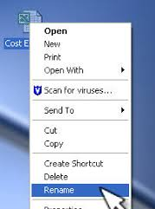
RENAMING FILES
Windows:
Right-click the file you want to rename, then select Rename from the menu.
Type the new name and press Enter.
Mac:
Click once on the file, wait for a moment, and then click again to make the file name editable.
Type the new name and press Enter.

Slide 8
MOVING FILES
To move a file, drag it from one location to another (e.g., from Downloads to Documents).
Alternatively, cut the file by selecting it and pressing Ctrl + X (Windows) or Command + X (Mac), then navigate to the folder where you want to move the file and paste it by pressing Ctrl + V (Windows) or Command + V (Mac).

Slide 9

FILE COMPRESSION TOOLS
Sometimes, files or folders need to be compressed (zipped) to save space or to send multiple files together.
How to Zip Files:
Windows: Right-click the file/folder, select Send to > Compressed (zipped) folder.
Mac: Right-click the file/folder, and select Compress.
To open a zip file, simply double-click it to extract the files inside.

